Slide 1
Broadband Access vs. Key Census Demographics
DeRon Holden
Max Mitchell
James rucker

Slide 2
Background
The availability of reliable broadband/internet is a major factor in the success of individuals, and specifically students, within communities. Having access to volumes of free knowledge and information, as well as the ability to make connections, is crucial to the development of people, young and old.
The ASU Tech Data Society, a joint effort between ASU and the U. of Iowa has developed a website that has captured the percent of broadband Access at a per-state, -county, -metro, and -city level.
This dataset is unique because prior to 2013, estimates of internet use from the Census were available only at the national and state levels [1].
[1] https://techdatasociety.asu.edu/broadband-data-portal/home

Slide 3
Goals/Plan
Download the broadband Access data from the Tech Society website.
Pull data from the US Census API related to
job types (NAICS),
race,
income,
median age,
poverty rate
population
Compare the broadband use on a county basis to the afore-mentioned US Census demographic variables. and determine correlation by use of linear regression to the US Census variation. The r-squared value will determine linear correlation.

Slide 4
Research Questions
IS A COUNTY WITH A LOWER MEDIAN AGE MORE LIKELY TO HAVE BROADBAND ACCESS?
ARE LOWER-INCOME COUNTIES LESS LIKELY TO HAVE BROADBAND ACCESS?
ARE COUNTIES WITH A PREVALENCE OF JOBS ASSOCIATED WITH information TECHNOLOGY MORE LIKELY TO BROADBAND ACCESS?
DO COUNTIES WITH HIGH POVERTY RATES TEND TO HAVE LOWER BROADBAND ACCESS?
Is there a relationship between THE RACIAL DEMOGRAPHICS OF A COUNTY and BROADBAND ACCESS?

Slide 5
Problems Encountered
Datasets had different geographic variables to key off of (geocodes, zip codes, counties), so comparison/ concatenation methods were needed to link datasets.
Census API’s were quite cumbersome to use. You could only pull one year at a time, one NAICS label at a time, requiring repeated pulls and merges, or loops.

Slide 6
Jupyter Notebooks

Slide 7
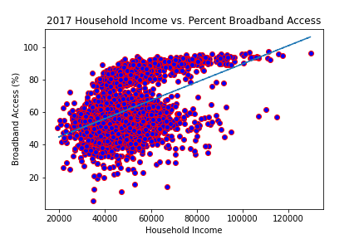
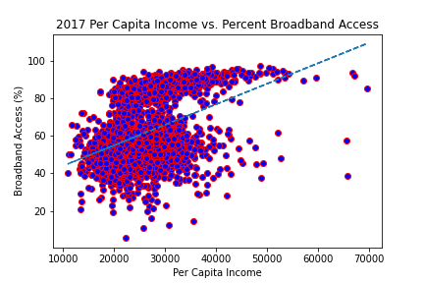
Results - Income
The r-squared for 2017 household income is 0.204.
The r-squared for 2017 Per Capita income is 0.176.

Slide 8
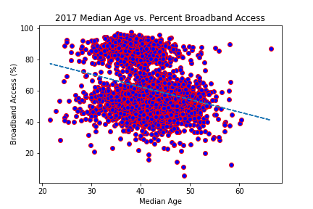
Results – Median Age
The r-squared for 2017 Median age is 0.07.

Slide 9
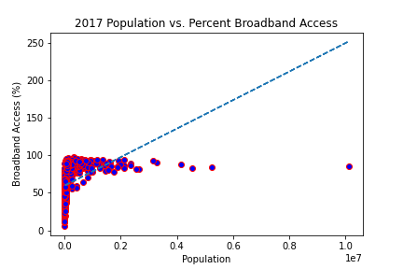
Results – Population
The r-squared for 2017 Population is 0.145.

Slide 10
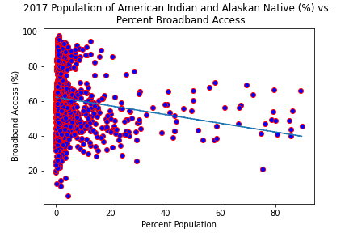
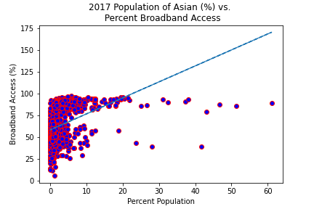
Results – Race
The r-squared for 2017 percent population of American indians and alaskan natives is 0.015.
The r-squared for 2017 percent population of Asians is 0.14.

Slide 11
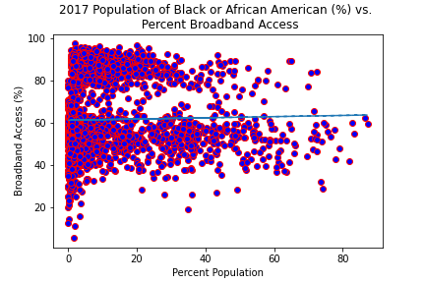
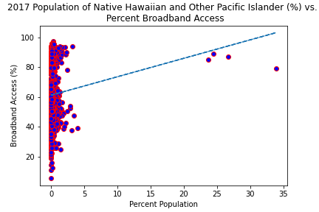
Results – Race
The r-squared for 2017 percent population of Black or African Americans is 0.001.
The r-squared for 2017 percent population of Native Hawaiians and Other Pacific Islanders is 0.006.

Slide 12
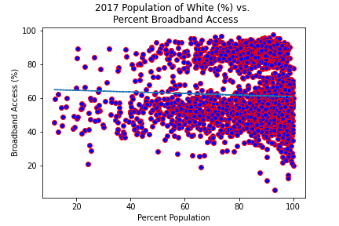
Results – Race
The r-squared for 2017 percent population of whites is 0.002.

Slide 13
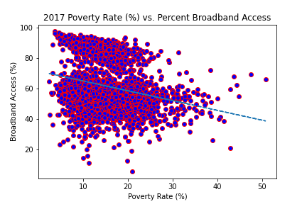
Results – Poverty Rate
The r-squared for 2017 Poverty Rate is 0.06.

Slide 14
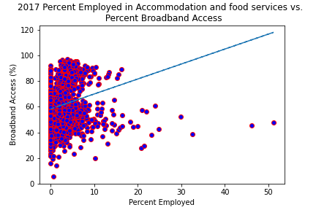
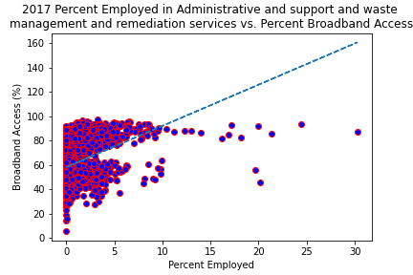
Results – Job Type
The r-squared for Accommodation and food services is 0.043.
The r-squared for Administrative and support and waste management and remediation services is 0.171.

Slide 15
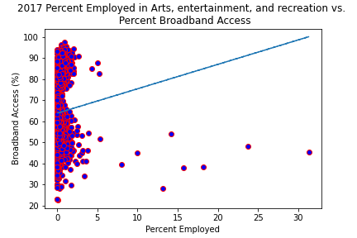
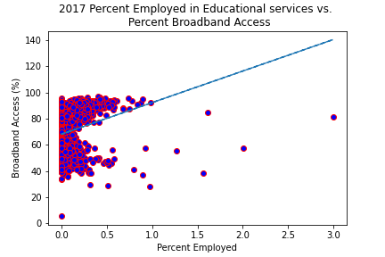
Results – Job Type
The r-squared for Arts, entertainment, and recreation is 0.006.
The r-squared for Educational services is 0.063.

Slide 16
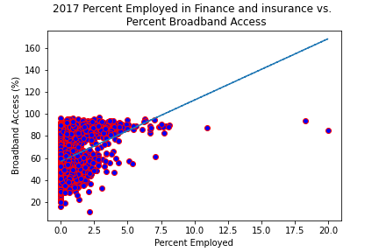
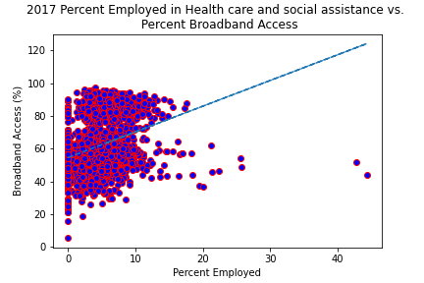
Results – Job Type
The r-squared for Finance and insurance is 0.137.
The r-squared for Health care and social assistance is 0.096.

Slide 17
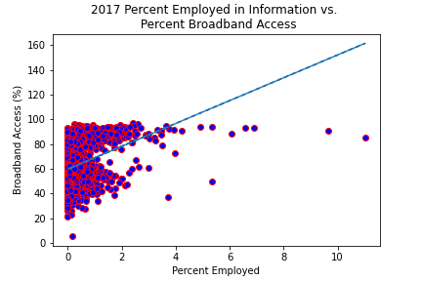
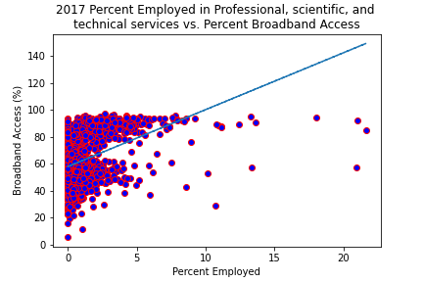
Results – Job Type
The r-squared for Information is 0.126.
The r-squared for Professional, scientific, and technical services is 0.147.

Slide 18
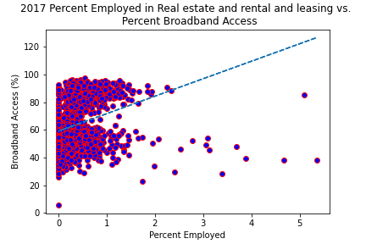
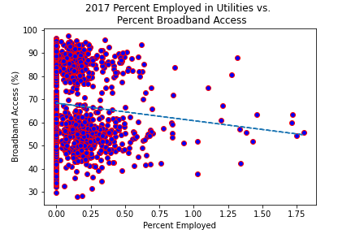
Results – Job Type
The r-squared for Real estate and rental and leasing is 0.09.
The r-squared for Utilities is 0.008.

Slide 19
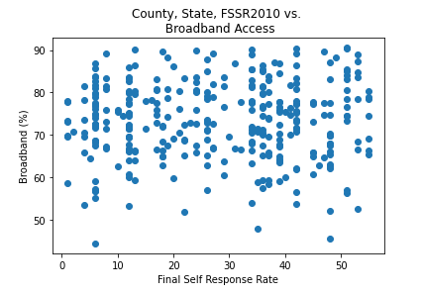
Results – Self Response

Slide 20
Conclusions
There were no strong correlations between BROADBAND ACCESS AND EACH OF the census demographic variables.
By rank, the strongest correlations existed between broadband access and:
Household Income / per-capita income (R² = 0.204)
Job type: Administrative/support/waste management/remediation services
Job type: Professional/scientific/technical services
Population
Race: Asian
Job type: Finance
Job type: Information Technology (R² = 0.126)

